Slide 1
Case Study Template
Showcase and demonstrate your expertise as a Cloud Solutions Provider using customer success stories!

Slide 2
Table of Contents
03 – About This Template
04 – Customizable Case Study Template
05 – Case Study Example
06 – Additional Design Tools

Slide 3
About This Template
When marketing your business, sometimes it seems like you can sing your expertise from the rooftops and it just doesn’t matter. However, having your customer sing your expertise from the rooftops is another story. Case studies can be a great way to showcase how your product or service made a big difference to in a customer’s success. But where to start? The following is a great template to build out your own case study.
Before we get started. When building out a customer success story, it’s a good idea to think about what format you want to display this in. Written, presentation, video or podcast? As long as you can capture a good story that makes your customer look like a rock star (that’s right, your customer, not just your business) there are a lot of great options that are relatively easy to put together (e.g., a single PowerPoint slide at an event or a podcast).
The template on the next slide will help you capture all essential details to create a written case study. Simply customize and fill in the details you need. Then export as a PDF to add to your website. As you grow your library of cases studies, consider creating a section of your website dedicated to partner success stories.

Slide 4
Adjust the background image to the industry you are working with, or use an actual photo from your customer for greater impact. If you should use a stock photo, Pexels.com is an excellent resource for stock photography.
Case Study Template
Challenge
Describe the challenge that was presented. Make sure you are not reiterating just what the customer was asking you to do (migration services) but the additional challenge that was faced (time constraints, bandwidth, different certifications or specializations than what is required for what is needed for the end result, etc.).
Insights
This is a great space to add some background to the situation and put the challenge into perspective. What is the current market like for the customer? What kind of business does this customer normally do with your company? For example, the customer might have been well versed in one specific product, but never in this new one.
Solution
Talk in detail about how the problem was solved. What steps were needed to get here? What did it take to deliver this solution successfully?
Services Used
Sell yourself/product/service here! Showcase the specific solutions or service that is unique to your company. What do they specialize in? How many years of experience do you have?
Result
Give them the final count. Now is the time to add to your hero status! What was accomplished in what amount of time? How much time did you save your customer? How much money did they make from this? Did they gain a loyal customer?
Make it compelling. Who is going to read this and what information are they looking for? We like to mention the customer’s industry and the type of work done so that our customers understand the service we offer the various specialized industries that we are knowledgeable.
Example: Public School Azure Migration
Case Study Title
Partner: [Insert Customer Name]
[Insert Customer
Logo]
Add a summary of what was needed so that you can jump in to the challenge in the body of the case study.
Get permission! It’s important the customer understands how their words and branding will be used. This goes for logos, quotes, and any other ways you might be using the customer’s feedback.
Founded:
Size: Ex: 51- 200 Employees
Website:
Industry: Ex: Public School System
Services Used: Ex: Azure Migration
“Gather a great quote from your customer! Make it big/position it prominently.” - Customer Name, Customer Title
Add your Call-to-Action. Your reader is hooked – Now explain why and how they can get a hold of you.
Example: Not sure what platform is right for you? Find out here (Link) and call 888.888.8888
EMAIL: YOUR EMAIL | WEB: YOUR WEBSITE | PHONE: YOUR PHONE
Your Logo

Slide 5
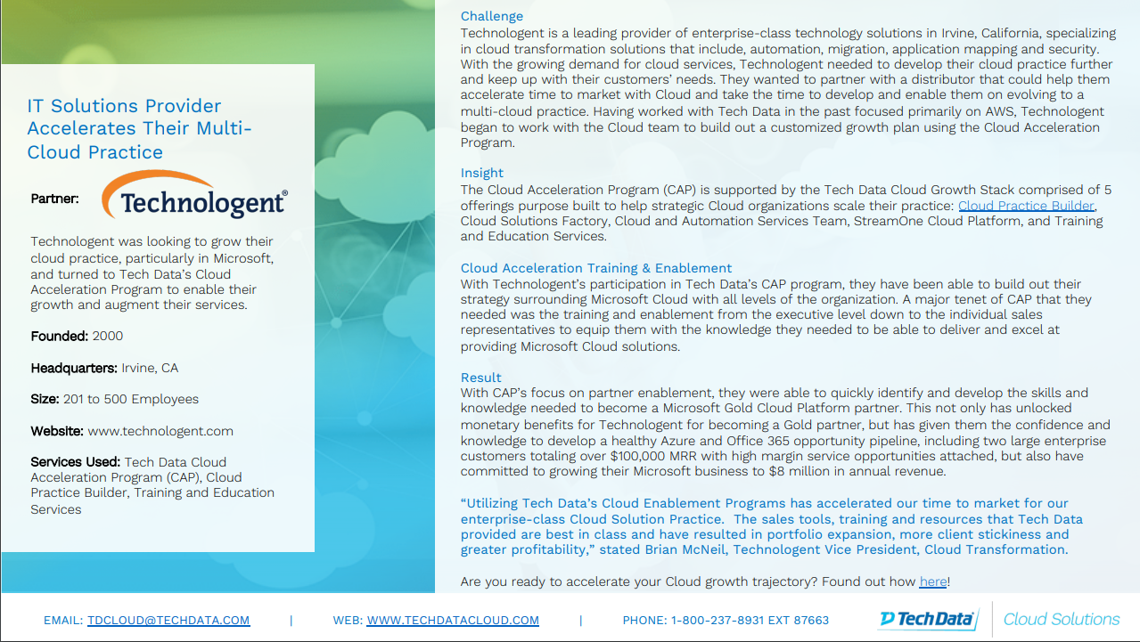

Slide 6
Additional Design Tools
Here are a few tools you can use to design your case study should you decide to make one from scratch or in a different format:
Your Existing Company Branded Template
PowerPoint Presentation – Presentation / PDF
Canva – Presentation / PDF
Adobe Spark – Digital/Web
Microsoft Sway – Digital
Video – grab your phone and a well-lit, quiet room

