Slide 1
Supplement Your Cloud Services with Tech Data
A guide to getting started

Slide 2
Introducing the Cloud Services & Automation Info Kit
This sales kit is designed to arm you with knowledge and resources to supplement your cloud services with Tech Data capabilities. In this info kit, we will provide an overview of our expertise and tools and would welcome an opportunity to help fill any gaps.

Slide 3
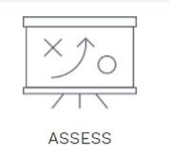
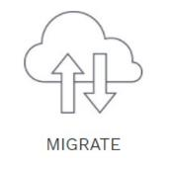
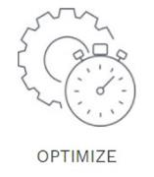
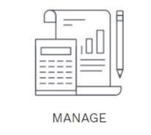
Who is the Tech Data Cloud Services & Automation (C&A) Team?
C&A provides Cloud Services and Automation tools that span the full customer lifecycle – assess, migrate, optimize and manage workloads.
C&A enables hybrid cloud in heterogeneous IT environments with our innovative software integration tools.
C&A has a specialized bench with deep Cloud and Data Center expertise to work hand-in-hand with partners to fill gaps.

Slide 4
Why Sell Tech Data Cloud Services?
Portfolio Expansion
Gain instant access to services, resources and tools to your help customers embrace the Cloud.
Experience with 200+ cloud projects to date and expertise in AWS, Azure, VMware, HP/Micro Focus, and Open Stack/Open Source. Plus integration experience with IT automation software including ServiceNow and BMC Software.
Instant Expertise
Greater Profitability
Enjoy higher margins with the ability to offer services across each stage of the customer lifecycle.
Enhance “Trusted Advisor” Status
Increase upsell opportunities through having more customer touch points.

Slide 5
Tech Data Cloud Services Span Customer Lifecycle
Assess
Migrate
Optimize
Manage
Instant portfolio expansion
Cloud Planning and Strategy Workshops
Cloud Design, Backups, Monitoring, Disaster Recovery
Flexible support models
Greenfield projects, Virtual Desktops
Access to expertise and tools
Workload Placement & AWS, Azure Assessments
App migrations to, from and within public, private, hybrid cloud
Automation services to deploy private/hybrid cloud infrastructure
Single service portal includes Service Desk, Support and Maintenance
White label option for partners
Next generation data center transformation
Old Database to New Database Migration
Integration services to/from ITSM, ITOM, and Automation platforms
Manage assets deployed across public and private cloud environments
Enhance “trusted advisor” status with customers
VMware optimization and upgrade assessments
On-prem-to-Cloud, Cloud-to-Cloud, Azure-to-Azure
VMware Implementations
End-to-end across apps, middleware and databases
Grow margins

Slide 6
AWS Services
Automation
Migrations
Development and Integration
Infrastructure
Assessments
Notes:
Assessments
Infrastructure
Compute and Networking
Architect and deploy auto-scaling and highly available IaaS and SaaS environments for POCs/development/test/production consisting of:
EC2 servers, Virtual Private Cloud (VPC) networks, NATs, Elastic Load Balancers, WAFs
CloudWatch and Service Management, Route 53 (DNS), Bastions, firewalls and ACLs, RDS databases
Storage
Backup / Recovery or Disaster Recovery planning and implementation using S3, Glacier
Storage solutions using AWS Storage Gateway
Automation
Architect and develop automation to deploy private or hybrid cloud infrastructure for POCs/development/test/production using any combination of AWS capabilities (CloudFormation, Terraform, AWS SDK, etc..), VMware vRA/vRO and/or HPE/Micro Focus Operations Orchestration
Migration Services
Migration of on-premise applications to AWS or hybrid cloud solutions
Provision VPN or Direct Connect connections to AWS
Azure → AWS
Reverse workload migration bringing Azure workloads into AWS systems
Development and Integration
Custom Integration Development with enterprise software from HPE/Micro Focus, BMC, VMware, IBM and others

Slide 7
Azure Services
Migrations
Assessments
Infrastructure
Application Development Integration
Optimization
Notes:
Assessments
Infrastructure
Greenfield projects to deploy new into Azure
Azure Networking – ExpressRoute, VPN (point to point and site to site)
Migrations
VMware to Azure
moving VMware workloads to Azure, and that starts with an assessment, architecting the supporting infrastructure, and migrating the systems over to Azure.
On Prem to Azure Cloud
we can work with your end customers and help them migrate their on-prem apps up to Azure. This can be as simple porting the workload directly to a VM running in Azure or assessing an application and them modernizing it to move into the cloud
Azure EA/PAYG to CSP
customer have existing workloads on EA, PAYG, or Open subs and you want to move them over to CSP. Instead of just migrating the VM workloads, we are looking at migrating all the existing resources
DB → DB including Old to New and Cross Platform Migration
Database upgrade / lift and shift
Database cross-platform migration
We’ve had customers that want to consider moving their on-premises databases from either physical or virtual machines to Infrastructure-as-a-Service (IaaS) machines, and we’ve also seen examples where they want to skip the VM altogether and try out Azure SQL Database, which is a Platform-as-a-Service (Paas) model where Microsoft handles all the underlying infrastructure pieces.
Application Development Integration
This includes evaluating your existing application portfolio to determine if your on-prem apps are ‘Cloud Ready’. If not, we would like to get our developers plugged in to help modernize an application and move it to Iaas, Web apps (Paas), or Containers.
Azure Container Service
Azure Kubernetes Service
Optimization
Runbook Automation – PS scripts to automate infrastructure taks
Other talking points:
Remote Desktop Service (RDS) – Deploying RDS solutions for customers that want virtualized desktops and/or terminal sessions hosted in Azure
Application Modernization
This type of activity includes an assessment process to evaluate your existing applications and it includes the services activities to then upgrade an app and move it into Azure
Cost Analysis – Cloud Migration ROI Calculator
Tech Data is working on a Cloud Migration ROI Calculator that can help you calculate the expected return on investment for moving existing Azure workloads to CSP. There are a few things to note here:
This calculator is only for existing Azure workloads moving to CSP
The calculator assumes a minimum $1,000 MRR on the subscription (we can do migrations less than $1k/month)
The calculator isn’t going to give you the exact price because every migration is different – especially if you factor in complexities like ASM to ARM upgrades, managed disks, etc.
The idea behind the calculator is you plug in your numbers and it will show you how long it will take to make up the migration cost (by the way you can potentially get MS to help fund the migration) and how much you can make by switching over to CSP in the first year, second year, etc.
Data → Data Migration / Translation / Archival
Migration of on-premise application data to Azure or hybrid cloud solutions using Tech Data IP
Provision VPN or direct Virtual Network Gateway connections to Azure

Slide 8
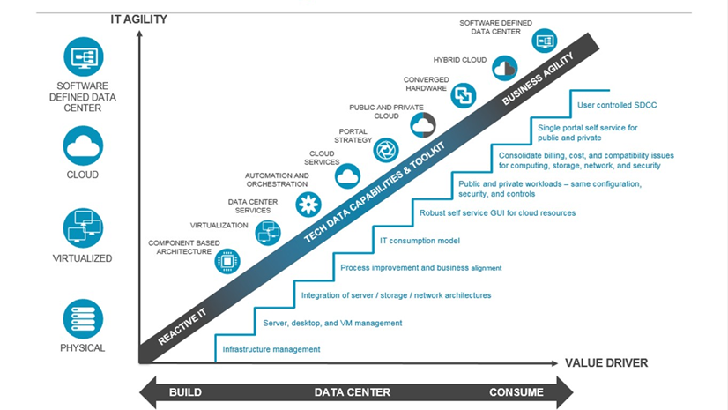
Deep Cloud and Data Center Expertise
Designed from the onset to help an organization achieve their goals at various stages on the cloud continuum ─ private, public, hybrid and software defined data center (SDDC).
Work with our partners and their customers to choose the right mix of cloud platforms and environments.
Address individual customer requirements at any stage of the cloud journey.
Cloud and Automation Maturity Scale - It’s about the end customer’s goal

Slide 9
Migration Success Story

Slide 10
Lead with Services to Simplify and Speed Customer Cloud Adoption
Cloud solution delivery is not something your team needs to do alone. The cloud professionals at Tech Data offer the services and bring the tools required for cost-effective implementation of even the most complex cloud migrations and hybrid solutions.

Slide 11
Enable Hybrid Cloud
Differentiate with Integration Tools
When an organization adopts cloud computing, it automatically adopts hybrid IT computing and as a result applications using different components move between the public cloud and data center. This presents integration and management challenges for customers.

Slide 12
Customers May Lack the Time, Staff, or Expertise to Embrace Cloud
Customers expect Solution Providers to be experts on the cloud and help them….
Understand Readiness:
Assess people, process and technology to document current environment.
Gain Alignment:
Define business goals and identify gaps across the organization that need to be addressed for success.
Reduce Complexity:
Rely on proven experts for guidance and technical skills to address complex
requirements.
Lower Risk:
Provide recommendations with financial information to make informed decisions for the organization.

Slide 13
Ask – Then Listen
Starting the conversation with your customers. Ask about:
Business goals for cloud – Learn about what the business expects from cloud adoption, current initiatives and timeframes.
Skills, Infrastructure and Process concerns – Where does the business have gaps in their cloud readiness.
Current state – Workload migrations, Hybrid cloud initiative, integration or IT management challenges, process improvement needs.

Slide 14
Learn As You Go
Don’t worry about knowing it all up front.
Take what you learn from interviews and use it to dive deeper, do research and ask follow up questions.
Adopting cloud is an ongoing journey, not an end state.
Engage with the business on their needs, and uncover sales opportunities.
Prioritize needs and identify business outcome.
Leverage your partnership with Tech Data to help with this process.
Notes:
Don’t worry about knowing it all up front.
Take what you learn from your interviews with business stakeholders and use it to dive deeper, do research, and ask follow up questions.
Security is a process, not an end state, and a comprehensive security approach will evolve as the business does.
The more you engage with the business on their needs, the better you’ll be able to meet their goals, be the trusted advisor, and uncover additional opportunities for revenue growth.

Slide 15
Cloud Services Sales Tools and Resources
Sales Tools and Resources Available for Partners
C&A Partner Datasheets
Marketing Collateral for You to Brand
Sales Resources
Cloud Assessment Datasheet
Cloud Migration Datasheet
C&A Services Overview Datasheet
White-labeled Cloud Services Overview Datasheet
White-labeled Assessment Datasheet
White-labeled Migration Datasheet
White-labeled Workload and Cost Analysis Assessment Datasheet
Sample Statements of Work
Sample Output /Deliverables
Cloud Assessment Scoping Questionnaire
Cloud Intro Readiness Survey

Slide 16
cloudpracticebuilder@techdatacloud.com.au
For more information on Tech Data Cloud Services and Automation contact…
www.techdatacloud.com.au

